Slide 1
Alcohol and Drug Counseling, BS
Substance Use Disorders, UCERT
Program Information

Slide 2
Who is this session for?
Bachelor of Science in Alcohol and Drug Counseling
Students who are:
New Students
Transfer Students, including students who have an ADC-T permit
Interested in obtaining the MN LADC Alcohol and Drug Counseling Licensure
Undergraduate Certificate in Substance Use Disorders
Students who have an:
Earned bachelor’s degree in an area other than Alcohol and Drug Counseling
Interest in obtaining the MN LADC Alcohol and Drug Counseling Licensure

Slide 3
Bachelor of Science in Alcohol and Drug Counseling, Overall Requirements

Slide 4
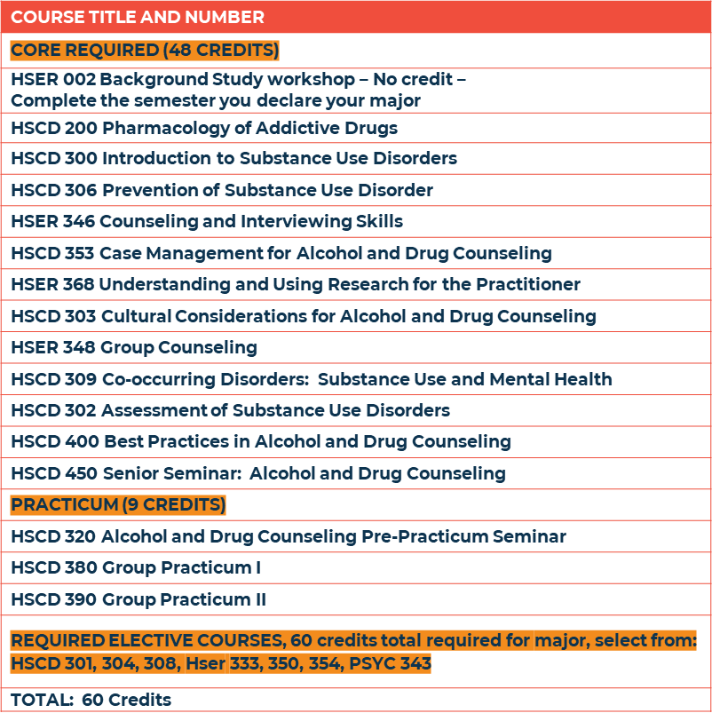
Bachelor of Science in Alcohol and Drug Counseling, Major Requirements (60 credits)
There are 12 core courses in the major, each 4 credits
880 hours must be completed to satisfy the LADC practicum requirement

Slide 5
Undergraduate Certificate in Substance Use Disorders, Program Requirements

Slide 6
Undergraduate Certificate in Substance use Disorders, Program Requirements (41 credits)
COURSE TITLE AND NUMBER
CORE REQUIRED (32 CREDITS)
HSER 002 Background Study workshop – No credit – Complete the semester you declare your major
HSCD 200 Pharmacology of Addictive Drugs
HSCD 300 Introduction to Substance Use Disorders
HSER 346 Counseling and Interviewing Skills
HSCD 353 Case Management for Alcohol and Drug Counseling
HSCD 303 Cultural Considerations for Alcohol and Drug Counseling
HSER 348 Group Counseling
HSCD 309 Co-occurring Disorders: Substance Use and Mental Health
HSCD 302 Assessment of Substance Use Disorders
PRACTICUM (9 CREDITS)
HSCD 320 Alcohol and Drug Counseling Pre-Practicum Seminar
HSCD 380 Group Practicum I
HSCD 390 Group Practicum II
TOTAL: 41 Credits
There are 8 core courses in the program, each 4 credits
880 hours must be completed to satisfy the LADC practicum requirement

Slide 7
Alcohol and Drug Counseling and
Substance Use Disorder Certificate Program Highlights
Graduates qualify for the MN LADC
Articulation Agreements with Anoka Ramsey Community College, Century College, and Minneapolis College
NASAC Accreditation
Mostly blended/hybrid courses with some online and some on campus
Additional Certification offerings (CPP, ICGC)
Applicant priority for Master of Science in Co-occurring Disorders Recovery Counseling program

Slide 8
Alcohol and Drug Counseling and
Substance Use Disorder Certificate Program Policies
Grades of C- or higher are required for courses in the major. If a course is repeated twice and a grade lower than C-is received a one-year stop out is required.
Course Equivalents: A maximum of 38 credits can be transferred into the BS ADC program; 16 credits into the SUD CERT program
Courses must be taken within the past 10 years to be eligible for the programs.
DHS Background Studies are required to enter the practicum
Applicants for the practicum must demonstrate a period of at least two years free from alcohol and other drug use problems preceding the practicum application date.

Slide 9
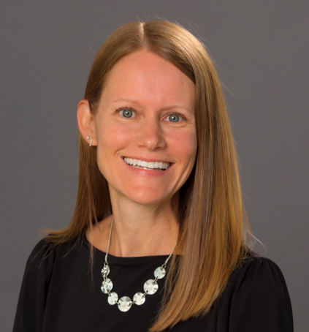
Contacts:

