Slide 1
School of Criminology and Criminal Justice (SCJ)
Online New Student Orientation
Program Information Meeting
Please review the notes for each slide as you move through this information.

Slide 2
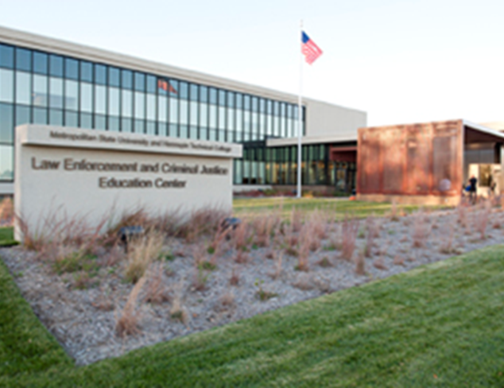
Welcome
School of Criminology and Criminal Justice (SCJ)
at the
Public Safety and Police Science Center (PSC)
9110 Brooklyn Boulevard Brooklyn Park, MN 55445 763-657-3749
Notes:
Welcome to the School of Criminology and Criminal Justice. We are excited that you are interested in pursuing one of our programs. Graduates of our programs work in a variety of areas within the criminal justice system, including all levels of law enforcement, probation, parole, non-profit organizations, the courts, corrections and community corrections, private security, and other related fields.
The School of Criminology and Criminal Justice is located within the Public Safety and Police Science Center in Brooklyn Park, MN. The SCJ Advising Center, faculty offices, some administrative services, and most major classes are located on site.
This presentation will assist you. The information will allow you to identify your academic advisor, prepare for your first semester registration, and identify next steps to declare your major. Throughout this presentation, we will refer to the School of Criminology and Criminal Justice as “SCJ”.

Slide 3
Program Information Meeting (PIM) Learning Outcomes
Programs overview
Academic advising
Major requirements and course sequencing
Requirements for acceptance to the major
Transfer course information
Registration tips and suggestions
Notes:
After viewing this Program Information Meeting, you should understand:
- the various criminal justice and police science programs offered at Metro State
- how to contact your Academic Advisor and the SCJ Advising Center
- the requirements to gain acceptance into the SCJ majors
- resources to assist you in understanding how your transfer coursework relates to your major
- and finally, SCJ registration tips and suggestions for your first term

Slide 4
Academic Advising for new students
Newly admitted students are assigned by last name.
Your advisor is available by email, phone, and scheduled appointment.
Contact your advisor to schedule an advising appointment.
Last name A-M, assigned to Mary Schober Martin mary.schobermartin@metrostate.edu
763-657-3751
Last name N-Z, assigned to
Cynthia Olson, cynthia.olson@metrostate.edu
763-657-3766
Notes:
The SCJ Advising Center is committed to providing you tools, resources, and advising that supports your educational, career and individual goals. We recommend that throughout your academic career at Metro State, you connect regularly with your advisor to ensure you are on-track and taking advantage of opportunities to enhance your academic experience and career preparation.
All newly admitted SCJ students are assigned to a professional academic advisor. Students are assigned an advisor alphabetically according to their last name, typically within a week of being admitted to the university.
Your academic advisor is available by email, phone, and scheduled appointment. Advising offices are located at the Public Safety and Police Science Center in Brooklyn Park, MN. You are encouraged to reach out to your advisors for academic advising support as needed. Remember to send all university correspondence from your Metro State student email account per university policy.

Slide 5
Preparing for your first semester
You are responsible for earning your academic degree. Academic advising services and tools are provided and intended to assist you in understanding your degree requirements. All academic planning, course registration and completion of degree requirements is ultimately your responsibility.
Notes:
It’s important for you to prepare for your first term at Metro State. You are responsible for earning your degree. The advising services and tools we provide you are intended to assist you in understanding degree requirements.
All academic planning, course registration and completion of degree requirements is ultimately your responsibility.

Slide 6
Preparing for your first term
You should:
Complete remaining new student tasks in a timely manner
Ask questions if you don't understand what you have read or have been told
Consult with your advisor to make certain you are choosing the appropriate courses
You can expect your Advisor to:
Help you understand your degree requirements and assist you with program decisions and registration
Answer your questions or refer you to appropriate resources & services
Respond in a timely manner, knowing peak advising times, like the start of a term, impact advisor availability
Notes:
As a college student we suggest you consider your responsibilities and what is expected of you. Also, consider what you can expect from this college experience and those resources and services available to you.
We strongly encourage you to meet with your advisor during your first semester to discuss your Educational Plan which includes your academic and career goals.

Slide 7
SCJ Advising Center
Public Safety and Police Science Center 9110 Brooklyn Boulevard Brooklyn Park, MN 55445 763-657-3749 Criminology.Advising@metrostate.edu
SCJ Advising webpage:
https://www.metrostate.edu/academics/community-studies/school-of-criminology-and-criminal-justice/advising
Notes:
The SCJ Advising Center is an excellent resource for new and current students seeking advising assistance. We highly recommend you visit the SCJ Advising Center website for helpful information on your next steps and degree planning tools.
The SCJ Advising Center and academic advisors periodically send email messages to your Metro State email account; checking email weekly is expected.
You may contact the SCJ Advising Center by phone or email with general questions or for assistance in scheduling an appointment with your advisor.

Slide 8
Why Choose This Major?
The Criminal Justice System
Notes:
There are many facets to the criminal justice system and many ways to work within the system. The SCJ majors will be a good fit for you if you are interested in gaining a broad knowledge of the criminal justice system, are looking to prepare for a new career, or are a practitioner in the field.
We encourage you to continue to explore career and major options during your first semester at Metro State to solidify your decision.
Working closely with the University Career Center is strongly encouraged.

Slide 9
Criminal Justice Major
Bachelors of Arts (BA)
Provides students with a broad overview of the system.
Leads to careers in areas such as:
Corrections
Courts
Probation
Parole
Government agencies
Notes:
Students who complete their degree requirement with a Criminal Justice major will earn a Bachelors of Arts degree. This major is appropriate for you if you are interested in learning and working within the criminal justice system or within systems that intersect with criminal justice issues.
A combination of required courses and elective courses will allow you to explore areas of interest specific to career goals. Students who earn this degree are often interested in careers in corrections, probation, parole, courts, non-profit work, and government agencies.

Slide 10
Criminal Justice Major with Police Studies Certificate
Bachelors of Arts (BA) and a certificate The Criminal Justice BA with Police Studies Certificate is a Minnesota Board of Peace Officer Standards and Training (POST Board) certified Professional Peace Officer Education (PPOE) program for students interested in becoming police officers.
Leads to careers in areas such as:
Local, county, state law enforcement
Federal law enforcement
Corrections
Government agencies
See also Criminal Justice major career areas
Notes:
Students who complete the degree requirements of the Criminal Justice major with the Police Studies Certificate will earn a Bachelors of Arts degree. In addition to the BA students will be awarded a Certificate. This major is appropriate for those interested in contributing to the criminal justice system as a licensed police officer in the state of MN. This major also supports students interested in working within the criminal justice system or related fields.
Required major courses will allow you to prepare for application into the Skills Program with Hennepin Technical College and to test with the Minnesota POST Board. Students who earn this degree are often interested in careers in law enforcement at the city, county, and state level. In addition, students might target federal level law enforcement and government agencies.

Slide 11
Minnesota Board of Peace Officer Standards and Training
MN POST Board
Students looking to complete the curriculum leading to eligibility for hire as a peace officer in MN please know:
Metro State is an approved PPOE by the State of MN POST Board (https://mn.gov/post/)
Minimum Standards are available on the POST Board website and are essential to review and confirm eligibility
Request a Police Studies Pre-application packet from our SCJ Advising Center
Notes:
SCJ offers programs in support of law enforcement through a few different opportunities. We work with students at all stages of their law enforcement career. Depending on the credits, degrees, or licenses held, there are options.
SCJ offers the Criminal Justice Major with Police Studies Certificate for those preparing to complete the educational requirements to test with the MN POST Board. The CJ Major plus Police Studies Certificate prepares you for entry level work as a licensed peace officer in the state of Minnesota. SCJ is an approved Professional Peace Officer Education or “PPOE” college through the Minnesota POST Board. It is essential you visit the Minnesota POST Board website to explore requirements and eligibility rules for becoming a police officer in Minnesota. In addition, please request a Police Studies Pre-application packet from our SCJ Advising Center.
Students who have already earned a Bachelor’s degree are directed to the stand alone Police Studies Certificate. Contact the SCJ Advising Center for more information about this program.
Students who are already Minnesota licensed peace officers or those with an earned associate degree and are license eligible, may consider the Police Science major, which is designed to integrate your completed associates degree into the bachelor’s degree requirements.

Slide 12
Police Science Major
Bachelor of Science (BS)
The Police Science BS is a “transfer pathways” degree for students who have already completed an associate’s degree in policing, law enforcement and/or are currently serving peace officers. This is an advanced policing degree designed for practitioners looking to advance their law enforcement careers.
Notes:
The Police Science major is best for those currently licensed as police officers, often in the state of Minnesota. Students who are already peace officers or those with an earned associate degree and are license eligible through the MN POST Board, may consider the Police Science major, which is designed to integrate your completed associates degree into the bachelor’s degree requirements.

Slide 13
Earned bachelors degree
The Police Studies Certificate is a stand-alone certificate option for students with an earned associate or bachelors degree.
The Police Studies Certificate is intended for students looking to test with the MN POST Board in preparation to become eligible for hire as a peace officer in MN.
Metro State is an approved PPOE by the State of MN POST Board (https://mn.gov/post/).
Minimum Standards are available on the POST Board website and are essential to review and confirm eligibility.
There is a competitive application process for the certificate program and working closely with SCJ Advising is necessary.
Notes:
Students who have already earned a Bachelor’s degree are directed to the stand alone Police Studies Certificate. Contact the SCJ Advising Center for more information about this program.

Slide 14
Exploring Your Major
Metropolitan State University Academic Catalog
https://www.metrostate.edu/academics
Notes:
We recommend exploring all majors you are considering within the online academic catalog.

Slide 15
Acceptance to the Major
Students must meet the following requirement to be accepted to the major: Pre-Major Advising Workshop (PAW)
Following completion of the required PAW students will submit required paperwork, including a major declaration eform and an Educational Plan.
Notes:
All incoming SCJ students are considered pre-majors. To gain major status, all undergraduate students must complete the required one-time, Pre-major Advising Workshop. We call this workshop a PAW.

Slide 16
Pre-Major Advising Workshop (PAW)
The Pre-major Advising Workshop (PAW) is designed for criminal justice, criminal justice with the police studies certificate, and police science students after admission to the University.
PAW sessions introduce students to SCJ programs, policies and procedures for Educational Planning.
This required comprehensive workshop focuses on degree requirements, and academic and career resources in support of your goals.
Upcoming PAW dates and signup instructions can be found online at the SCJ Advising website or by using this link.
Notes:
A Pre-Major Advising Workshop or PAW, is a required comprehensive workshop focused on degree requirements, and academic and career resources. Completion of the PAW can be through a scheduled workshop or independently within D2L paired with an Educational Planning Advising Appointment.
Contact your advisor or the SCJ Advising Center for more information about a PAW. Completion of a PAW is a requirement for criminal justice, criminal justice with the police studies certificate, and police science students to declare their major.

Slide 17
Degree Requirements
Your degree audit tracks your requirements, section by section, and is the best tool to manage your degree requirements. Reading and using your degree audit is essential to best manage your Educational Plan.
To earn your degree you must meet all
course requirements and credit requirements.
Notes:
The purpose of this online PIM is to provide you introductory information to assist in first semester registration. During the PAW, degree requirements will be reviewed in detail.
To earn your degree you must fulfill all course requirements and credit requirements.
On your degree audit you will find your degree requirements listed. These requirements must be completed at time of graduation. Transfer courses may fulfill some requirements. Transfer coursework will be highlighted later.

Slide 18
Degree Requirements
Course requirements include:
Courses:
GELS (Goal Areas one - ten)
Major
Electives as needed
Credit requirements include:
Credits
120 credits total (transfer and at Metropolitan State University)
40 credits at the upper division
30 credits at Metropolitan State University (residency requirement
… etc…

Slide 19
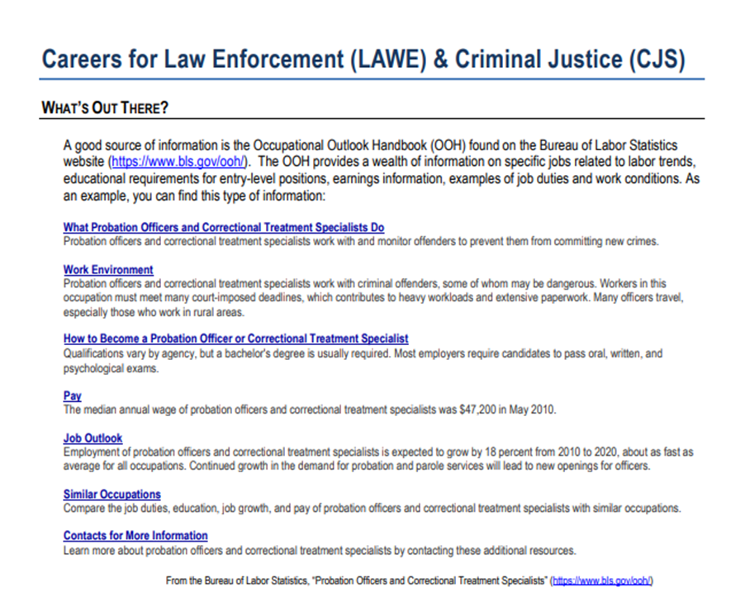
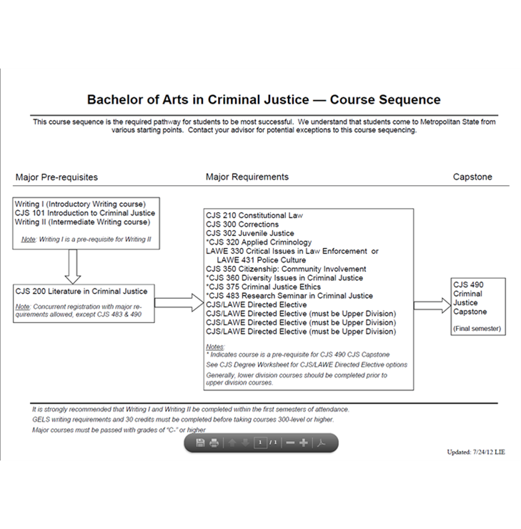
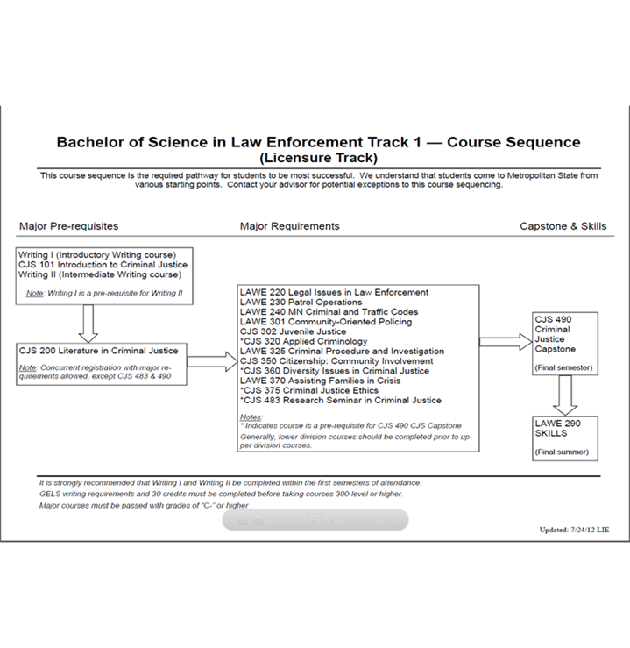
Tools for degree planning
Available on the SCJ Advising website
Notes:
There are many helpful advising and degree planning tools available on the SCJ Advising website including; sequencing charts, internship resources, and frequently asked questions.
Using these tools, along with your Degree Audit found within eServices, will assist you in planning courses for your first semester at Metro state.

Slide 20
Introductory Courses
SCJ Prerequisites (for most major classes)
CJS 101 Introduction to Criminal Justice
CJS 201 Foundations in Criminal Justice
Transfer students: These courses are a priority for your first term registration. If you have already successfully completed an Introductory to Criminal Justice course, you should confirm applicability to the major requirement before registration.
Notes:
SCJ faculty established specific prerequisites for major courses within SCJ majors. CJS 101 Introduction to Criminal Justice and CJS 201 Foundations in Criminal Justice are prerequisites for most major courses and concurrent registration is typically not allowed. If you are a transfer student you should consider registering for these courses your first term at Metro State, if not already fulfilled with transfer credit.
You are expected to adhere to prerequisites listed in the catalog and course schedule.
You may be restricted from registration or dropped from a course if prerequisites are not met.

Slide 21
Minors Offered
Criminal Justice Minor 22 credits, six courses
CJS 101 Introduction to Criminal Justice - 3 credits
CJS 201 Foundations in Criminal Justice - 3 credits
CJS 300 Corrections & Community Corrections - 4 credits
CJS 305 Criminal Court System - 4 credits
CJS 320 Criminology & Public Policy - 4 credits
CJS 360 Diversity in Criminal Justice - 4 credits
Notes:
Metro State offers a variety of minor areas of study. A minor allows you to explore a specific discipline with less course commitment than a major. A minor may compliment your chosen major or simply be an area of personal interest you would like to study. Choosing a minor is optional and not required for graduation.
SCJ offers only one minor, a minor in criminal justice. This minor allows students to explore the criminal justice system and includes specific Criminal Justice courses to provide an overview of our Criminal Justice system in the United States of America. Required minor courses total 22 credits.
If you are majoring in Criminal Justice you may not minor in Criminal Justice. If you are majoring in Police Science you may not use major required coursework to also meet the minor requirements; alternative courses may be substituted.

Slide 22
Transfer Coursework
Transfer Pathways
Criminal Justice https://www.metrostate.edu/apply/path/pathways/criminal-justice
Law Enforcement https://www.metrostate.edu/apply/path/pathways/law-enforcement
Transferology www.transferology.com
Evaluation of major transfer courses
Notes:
There are Transfer Pathway’s available for SCJ majors at Metropolitan State. If you complete a Transfer Pathway degree program at a Minnesota State college and are admitted to Metropolitan State, you will be guaranteed junior status and given assurance that all 60 college credits will count toward the related bachelor’s degree. Please connect with your advisor regarding your specific transfer courses and situation, your course plan may differ from the suggested course plan on the website.
Transferology, an online tool, can help you understand how your coursework transfers into the major.
If you would like to have a transfer course considered for evaluation to fulfill a major course requirement, there is a formal request process. You can review the Transfer Review process in eServices under Academic Record, or work with your advisor to identify possible courses and next steps.

Slide 23
Suggestions for First-Year Students
It is highly recommended that first-year students meet with an academic advisor to discuss registration options.
Courses to consider:
METRO 101 Your Academic Journey - Required for all first-year students
Goal 1 introductory writing course (dependent on placement assessment)
Lower division (100 level learning) GELS courses as available/appropriate, depending on placement
Notes:
If you are a first-year student and have never attended college, it is highly recommended that you schedule an advising appointment with your advisor to discuss your academic and registration plans. Registration recommendations are often dependent on placement assessment.
All first-year students are required to take METRO 101 Your Academic Journey their first term.
Additional course recommendations typically direct students to a Goal 1 introductory writing course and other lower division GELS courses as available and appropriate.

Slide 24
Suggestions for Transfer Students
First term recommendations include:
Introductory Writing/WRIT 131 (Goal 1) if not already met
Intermediate Writing/WRIT 231 (Goal 1) if not already met
CJS 101 Intro to Criminal Justice if not already met
CJS 201 Foundations in Criminal Justice
Other GELS requirements not complete
CJS directed electives (for CJ majors) or other electives
Consult with your advisor to review registration options
Notes:
If you are a transfer student, you should refer to your degree audit to determine if specific requirements have been met.
SCJ recommends these registration options for your first term:
Introductory Writing/WRIT 131 (Goal 1) if not already met
Intermediate Writing/WRIT 231 (Goal 1) if not already met
CJS 101 Intro to Criminal Justice if not already met
CJS 201 Foundations in Criminal Justice
Other GELS requirements not complete
CJS directed electives (for CJ majors) or other electives
Consult with your advisor to review registration options

Slide 25
Registration Tips
Ensure you are prepared to register on your priority registration date.
Best Advice:
Review your degree audit – read it & refer to it regularly
Review eservices and advising tools
Email your academic advisor with questions
Notes:
Ensure you are prepared to register on your priority registration date. Your registration window will open based on earned credits. Our Veteran and active military students will gain registration access on day one.

Slide 26
Registration Tips
SCJ faculty cannot grant entrance into a full class.
The waitlist function is used for most SCJ courses
students are expected to monitor their student email daily when using the waitlist
the waitlist turns off the Wednesday before the start of a term
Contact your advisor for assistance in requesting entrance into a full CJS 101 or CJS 201 course.
Notes:
SCJ faculty are unable to grant permission for students to be added to a full class. Do not contact faculty and make this request. Students attempting to register for a full SCJ course should use the waitlist function. If you use the waitlist, its important to monitor your Metro State email daily, including weekends and holidays, for a waitlist offer.
If you are interested in registering for a full section of CJS 101 Introduction to Criminal Justice or CJS 201 Literature in Criminal Justice, contact your advisor to discuss the enrollment process.

Slide 27
Thank You!
Contact us with questions or to schedule an advising appointment. We look forward to working with you on your educational journey!
Return to the online New Student Orientation and complete the remaining required sections.
Notes:
This concludes the online Program Information Meeting for the School of Criminology and Criminal Justice. If you would like to discuss information within this section or other topics within orientation, please contact your advisor.
Be sure to return to the online new student orientation and complete the remaining required sections.

Slide 28
Closing Page
Updates: 2/1/2024 SCJ Advising Team

